Slide 1
Two case studies, one construction
What the onset year inside the trend window did to the GMT and Arctic SIE slowdown problems — and how to write it up
Lauren Hoffman — for discussion with Zach Labe — September 2026

Slide 2
The construction
A slowdown is a decade whose least-squares trend is anomalously weak. The window starts at the onset year t, so the state at t is the first point of the fitted line.
For a series with no memory at all, the slope b over w points and the first value y₀ have
corr(b, y₀) = −√( 3(w−1) / (w(w+1)) ) → −0.71 (w = 2, 3), −0.63 (w = 5), −0.50 (w = 10)
so a decadal window hands R² ≈ 0.25 to any predictor of the onset state before any physics; it is exactly zero once y₀ leaves the window (start at t+1).
Known as Oldham's problem / mathematical coupling (biostatistics, 1962), spurious self-correlation (Pearson 1897; geoscience), target leakage (Kaufman 2012; Kapoor & Narayanan 2023). New in the trend-window form.
It passes every temporal-leakage check: no year of the target lies in the predictor's past. The leak is in the algebra of the label, not in time.

Slide 3
In CESM2-LE: state at onset → decadal trend anomaly (test R²)
window starts at | t (onset-inclusive) | t+1 | t+2 | white noise
September SIE, from SIE anomaly | 0.28 | 0.075 | 0.04 | 0.25 → 0 → 0
annual GMT, from GMT anomaly | 0.26 | 0.03 | 0.00 | 0.25 → 0 → 0
Roughly ¾ of the ice-state "predictability" and ~90% of the GMT-state predictability is the construction. What is left at t+1 is the physical memory of the state.
GMT has less decadal memory than the ice, so an onset-inclusive GMT label is, to a closer approximation, a picture of the current state.
Everything that follows uses the offset window t+1 … t+10 ("off1" labels, onsets 1990–2029, prevalence 0.17).
Figure in the manuscript: gmt_coupling_check (bars + white-noise line). Numbers from 09_gmt_coupling_check.py, 100 members.

Slide 4
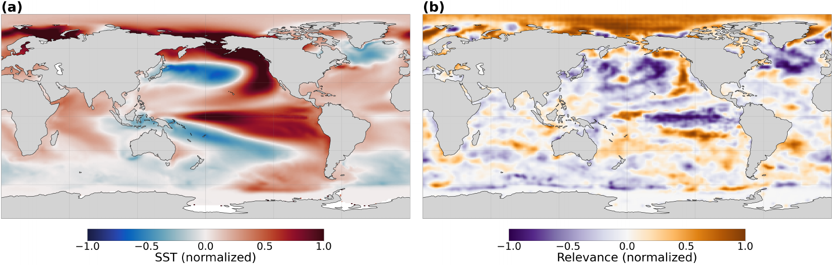
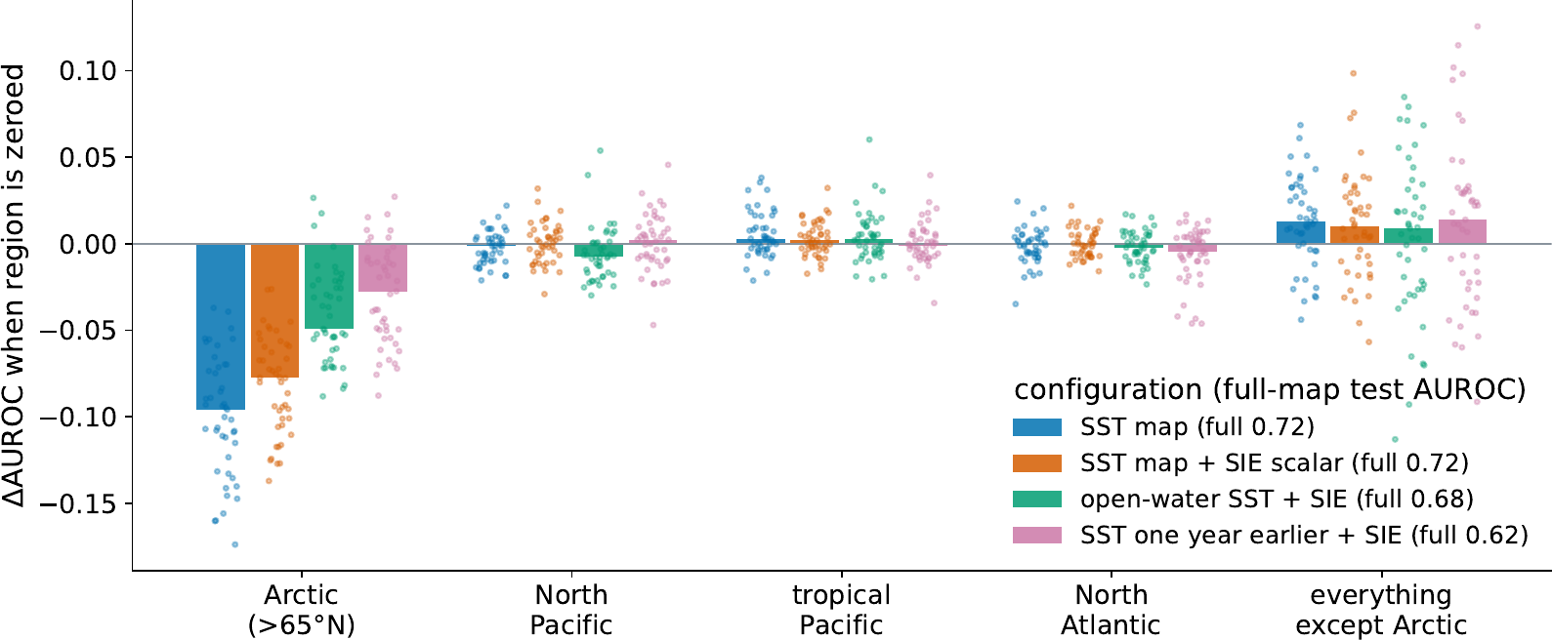
SIE case: where the network looks vs what it uses
LRP over correct slowdowns: Arctic marginal seas plus a tropical / North Pacific pattern — the regions the literature predicts.
Occlusion: zeroing the Arctic costs 0.08–0.10 AUROC; zeroing the North Pacific, tropical Pacific or North Atlantic changes it by ≤ 0.007; zeroing everything except the Arctic raises AUROC.
The Arctic relevance is the onset ice state read through summer SST (r ≈ −0.6 to −0.8). The Pacific relevance carries no skill.
Four XAI methods agree on the maps (LRP-z, α2β1, DeepTaylor, input×gradient). They faithfully explain a network that learned the label construction.

Slide 5
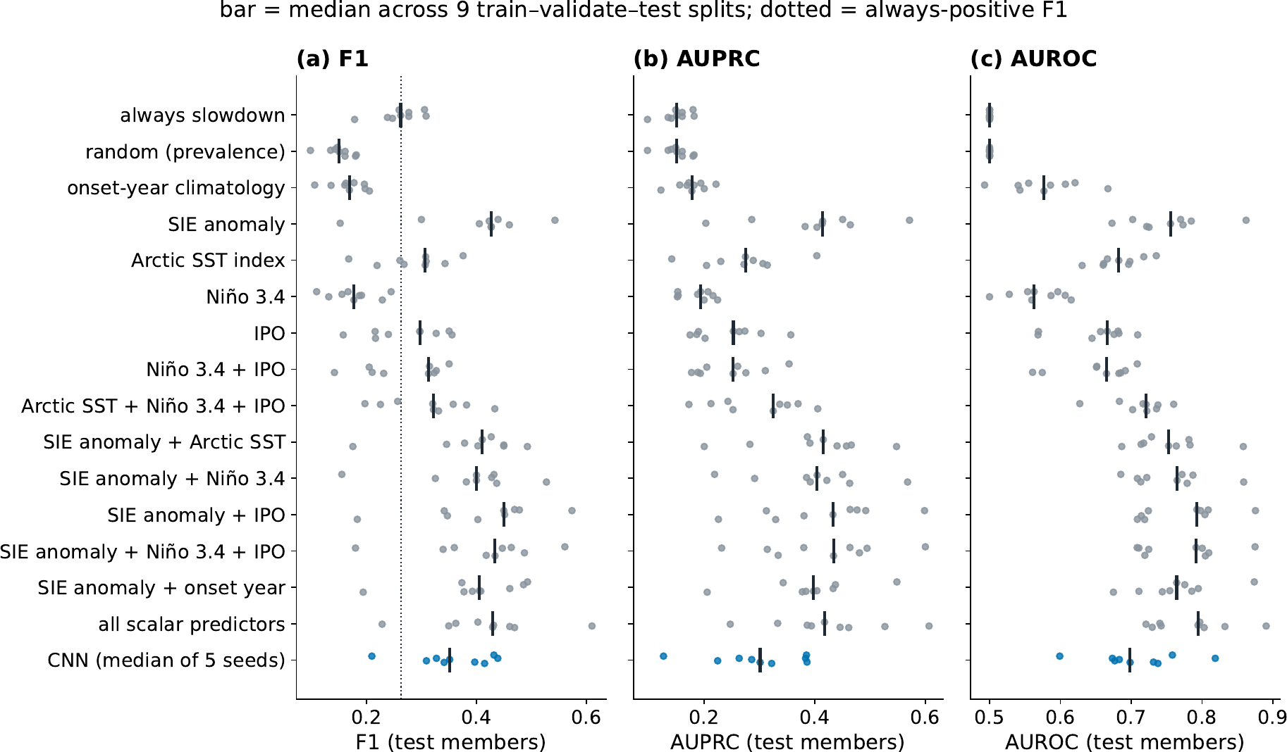
SIE case: a one-variable regression beats every network
off1 labels, test AUROC
logistic: SIE anomaly | 0.61
logistic: SIE + siv | 0.65
logistic: IPO | 0.66
logistic: SIE + IPO | 0.68
CNN base (SST map) | 0.62
CNN aux, warm-started | 0.62
CNN extra-Arctic (>50°N zeroed) | running
Onset-inclusive labels: SIE logistic 0.77, SIE+IPO 0.80, best CNN 0.72.
Offset labels: the CNN equals the ice-state logistic; the aux CNN's probability tracks the SIE anomaly (r = −0.77).
The extra-Arctic network is the paper's clean test of the Pacific reading.

Slide 6
GMT case, with the LB22 predictor (annual OHC100, 50 CMIP6 members)
predictor → GMT slowdown | R² (window at t) | AUROC (t) | R² (t+1) | AUROC (t+1) | r(pred, GMT state)
GMT state at onset | 0.24 | 0.78 | 0.02 | 0.59 | —
OHC100 map, 20 PCs | 0.27 | 0.78 | 0.09 | 0.69 | −0.84
map + state | 0.30 | 0.80 | 0.09 | 0.69 | −0.84
On the onset-inclusive label the OHC map is indistinguishable from the GMT state alone, and its prediction is a picture of the current GMT (r = −0.84).
With the window moved one year the state collapses but the map does not: about ¼ of the onset-inclusive skill is real decadal memory in the upper ocean; ¾ is the construction.
Ridge / logistic on PCs, member-block test splits. Single held-out block shown; five-block medians and an LB22-style MLP row are running (lb22_cv).
We have not retrained the LB22 network on its data — this is the LB22 predictor and label construction inside CESM2-LE with the missing control added.

Slide 7
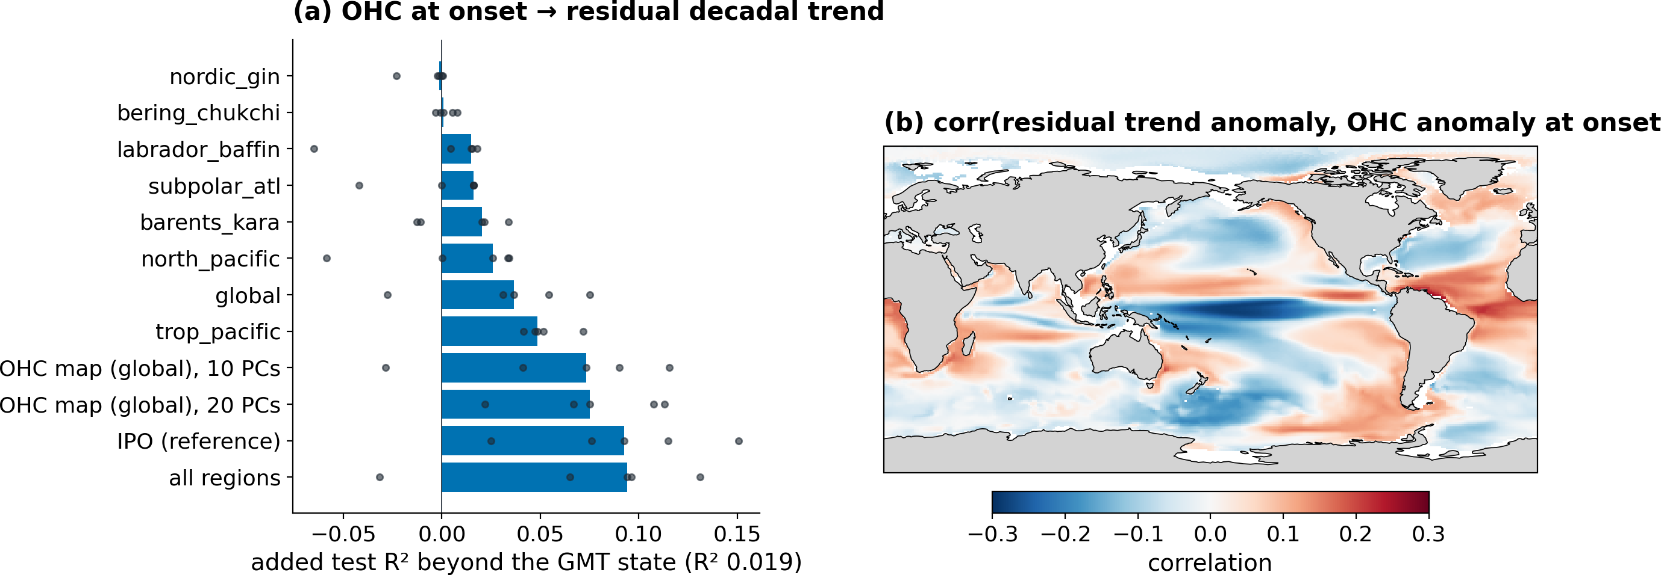
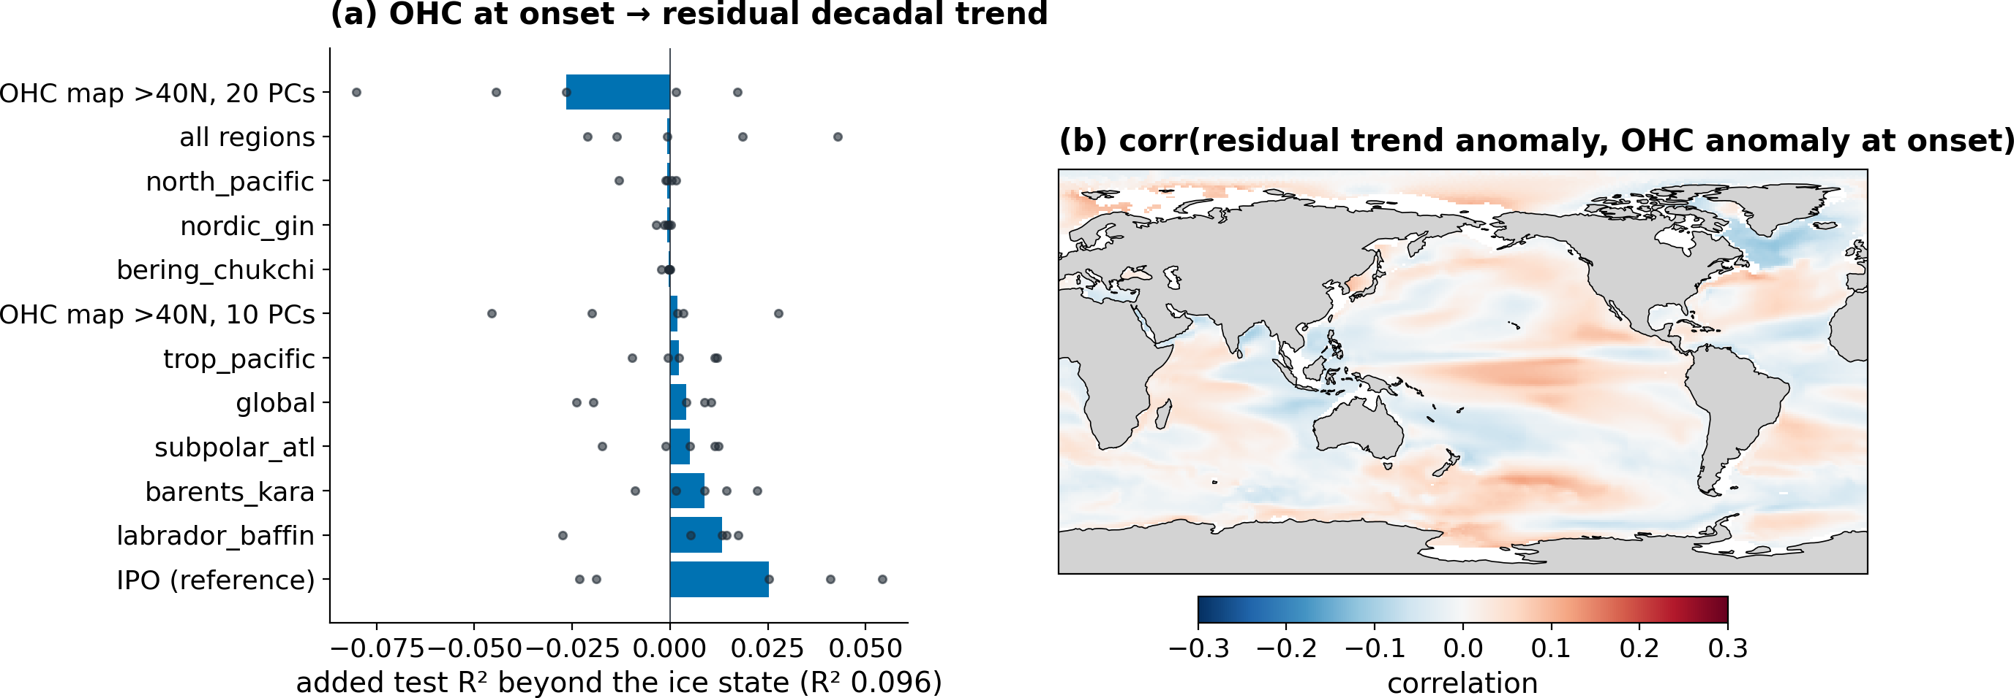
Where the decadal memory lives: OHC at onset beyond the target's own state
GMT (annual OHC100): state alone R² 0.02; ocean adds up to +0.09 (IPO), +0.07 (global map), +0.05 (tropical Pacific). Residual pattern = negative IPO.
SIE (JJA OHC100): ice state alone R² 0.10; no OHC predictor adds > +0.013; IPO +0.025. The memory is in the ice, and the SST map already pictures it.

Slide 8
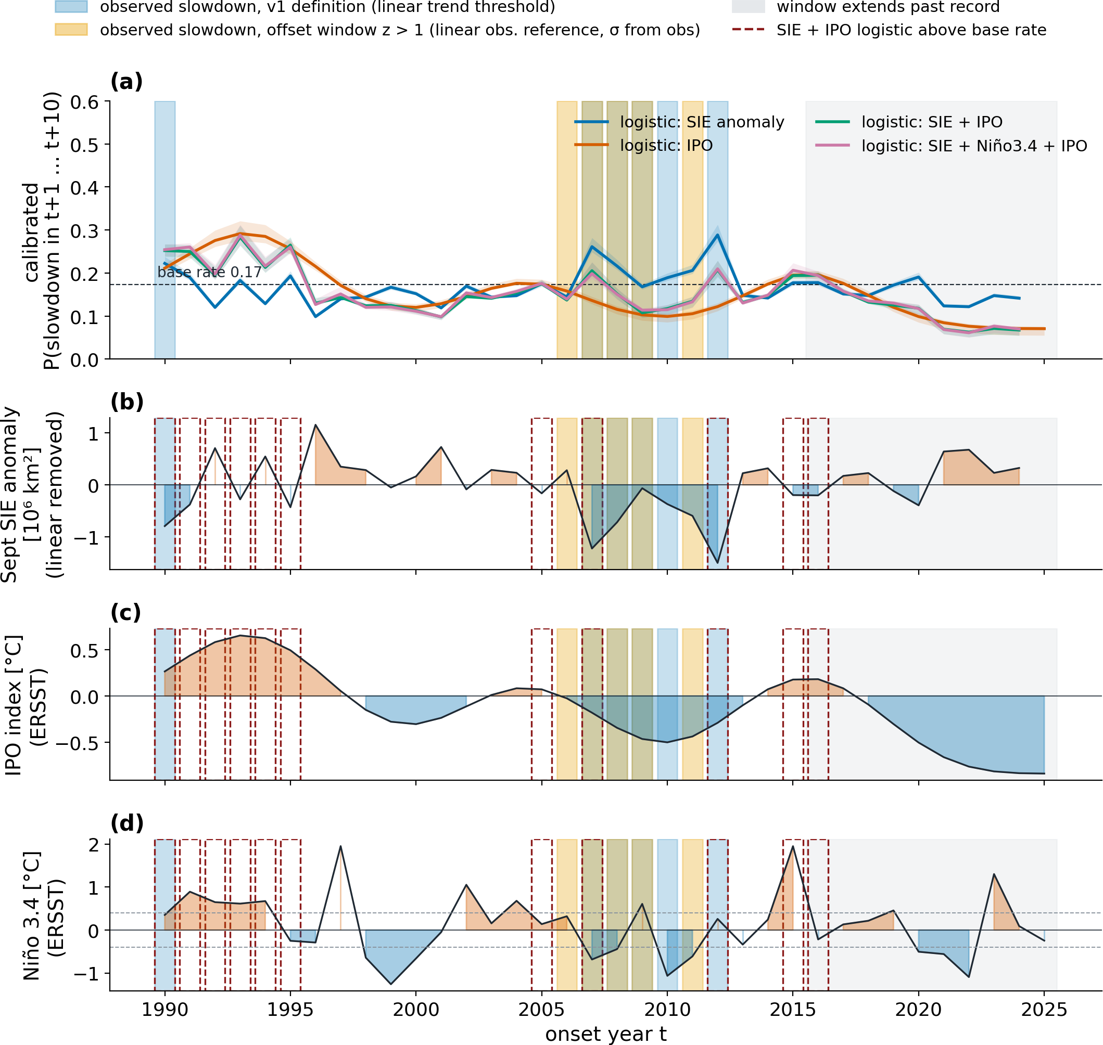
Observations: calibrated baseline probabilities, observed slowdowns
Logistic fits from CESM2-LE (offset labels), applied to the observed SIE anomaly, IPO and Niño 3.4; calibrated to the base rate 0.17.
Blue: observed slowdowns by the v1 definition. Amber: decades that are slowdowns by the offset test with an observation-only linear reference and observed σ.
During the observed 2005–2010 onsets every baseline sat below the base rate (0.10–0.17): weak ice and a negative IPO argued, in CESM2's sign, against a slowdown. The one flagged period (1990–94, P 0.25–0.30) did slow.
With CESM2's σ (0.129 Mkm² yr⁻¹, ~2× observed) no observed onset reaches 1σ (max z = 0.74, onset 2006): the pause is a slowdown only by the observations' own variability.
2016–2025: all baselines at or below the base rate. CNN votes to be added from the off1 networks.

Slide 9
The other decadal ML designs in the group are not exposed
study | input (time) | target | window starts | coupling | state baseline
Labe & Barnes 2022 | OHC100 map, year t | 10-yr GMT trend, t…t+9 | t | yes | IPO logistic only
Gordon, Barnes & Hurrell 2021 | OHC maps, −38…−30 mo | PDO sign change, −30…0 mo | after input | no | none (chance)
Gordon & Barnes 2022 | OHC, 60-mo mean to t | 60-mo SST mean, t+12…t+72 | t+12 | no | persistence (beaten)
Rader & Barnes 2023 | 5-yr SST mean, t−4…t | 5-yr N. Atl. SST, t+1…t+5 | t+1 | no | mean-evolution proxy
Fernandez & Barnes 2025 | tas, years i, i−1, i−2 | tas in year i+L | i+1 | no | none
The trend-window label is the exception, not the rule: every other design predicts a forward mean or a single future year — the offset convention our off1 labels adopt. Written as a forward mean, the coupling disappears.
What recurs across the literature, clean designs included, is the missing baseline on the state the input pictures. That is checklist rule (ii), independent of the coupling.

Slide 10
Proposed framing: an AIES "Lessons Learned" paper
Template: Mamalakis, Barnes & Ebert-Uphoff (2023), "Carefully choose the baseline" — one lesson, stated as an imperative in the title, demonstrated on our own application, turned into rules.
Working title: "Keep the onset year out of the window: lessons learned from predicting decadal trend slowdowns with neural networks and explainable AI".
Two case studies, one construction, written in the first person plural: the control was missing from both; applied to both with each study's own predictor, the outcome differs for a physical reason (memory in the ocean vs in the ice).
LB22's physical reading — the Pacific decadal state — survives; the quantified skill and the pattern maps largely do not. The SIE result is almost entirely construction.
The general lesson is portability: the same design was ¼ artefact in one system and nearly all artefact in another, and skill scores, XAI coherence and an observational hindcast were consistent with both.
Six main figures: mechanism · XAI vs occlusion · skill vs baselines (incl. extra-Arctic CNN) · OHC ledger GMT vs SIE · observations · (schematic). Rest to SI.
Rules: offset the window or use a state-free target · state baseline first · occlusion beside relevance · verify scalar inputs are used · learning curves · check teleconnection sign · ask what the new target's own state explains before transplanting a design.

Slide 11
Questions for discussion
1. Are you comfortable with the two-case-study, first-person-plural framing, and with the title?
2. Anything in the LB22 setup we have misread — label construction, OHC depth, detrending, the IPO baseline — that would change the ¾ / ¼ split?
3. Would you want to re-run a state baseline on the original LB22 data / networks, and should that be in this paper or a separate note?
4. Is there a Climate Central internal-review requirement for the manuscript?
5. The GMT ledger says the real memory is the IPO. Is that consistent with how you read the LB22 relevance maps at the time?
6. Anyone else who should see this before submission (Barnes group)?

